Slide 1



Technology store web
TNT Team

Slide 2
Team members
Huynh Nguyen Tan Nhac (Team leader)
Tran Trung Thanh
Tran Vu Thien

Slide 3

Introduction
Commercial website are more and more familiar with us in our daily lives.
The project is built for customer to purchase and seller to access and manage the products on the browser.

Slide 4
Project Scope
Our project is aim to create a easily operate website for both customer and seller.
Customers are easily access with a simple interface to shop
Sellers can manage and handle the products on the web.

Slide 5


Development technology and tools
Frontend: Angular, HTML, CSS, JS, TS
Backend: Java, Spring Boot
Database: MySQL
Tools:Eclipse, Visual Studio Code

Slide 6
Module
We have an admin module along with that we have some other modules:
Cart
Dashboard
Order Details
Order
Product
Product Single
Profile Details
Login
Sign Up

Slide 7
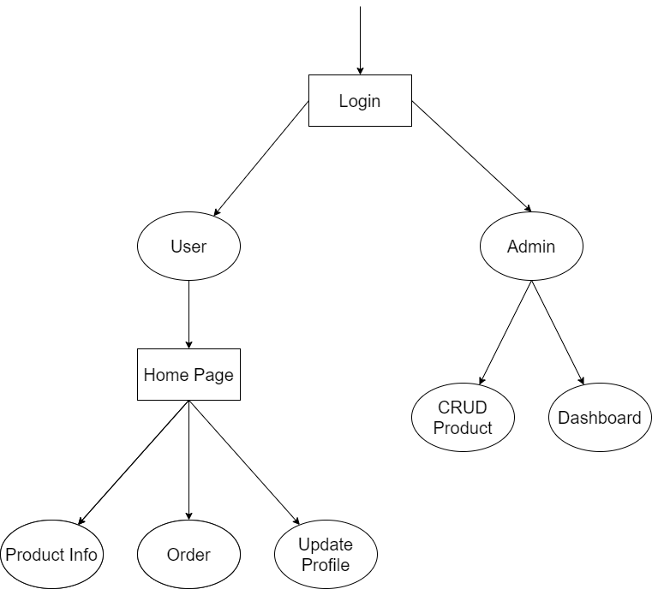
DATA FLOW DIAGRAM

Slide 8
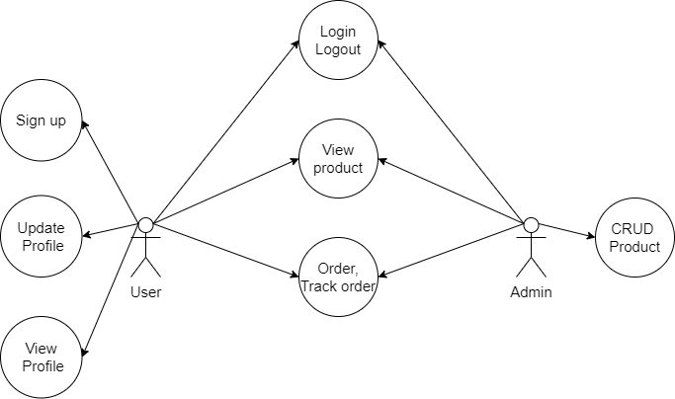
Operation diagram

Slide 9
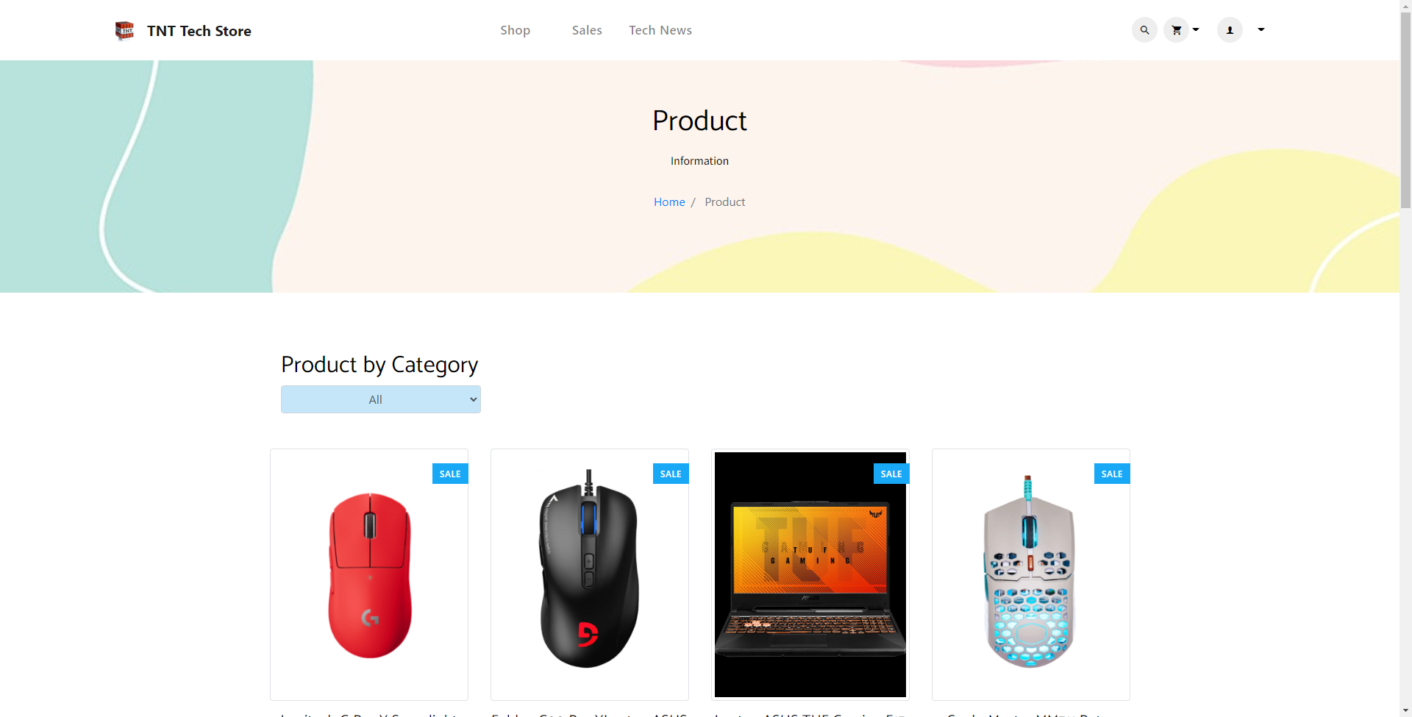
Homepage

Slide 10
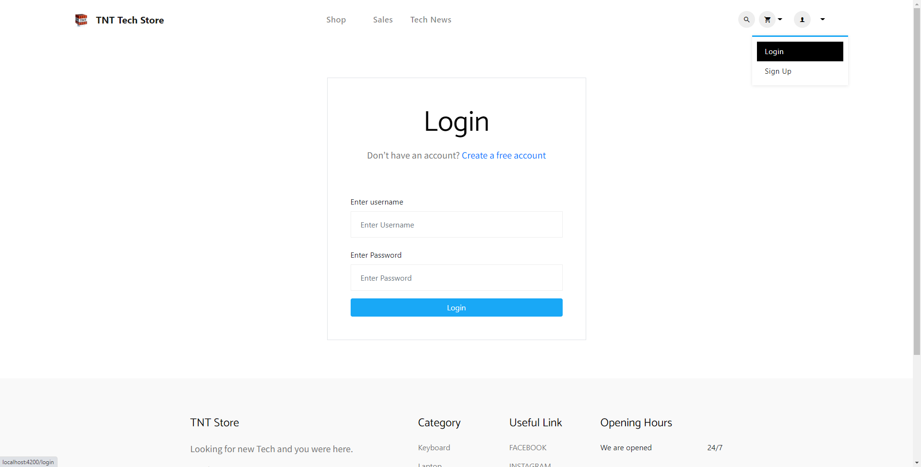
Login page

Slide 11
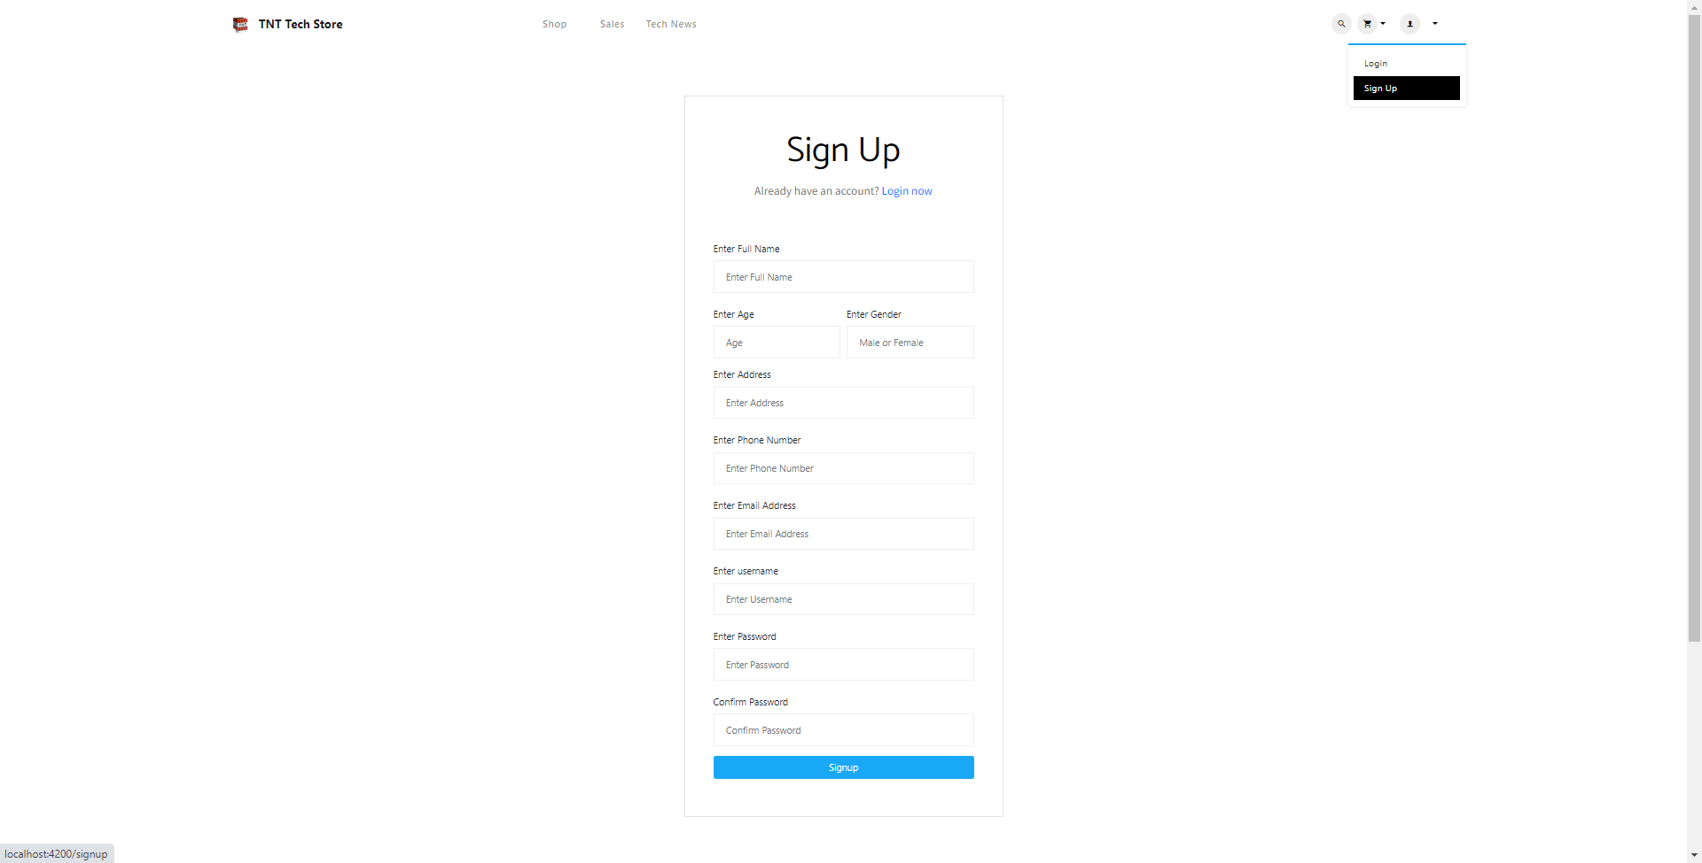
signup page

Slide 12
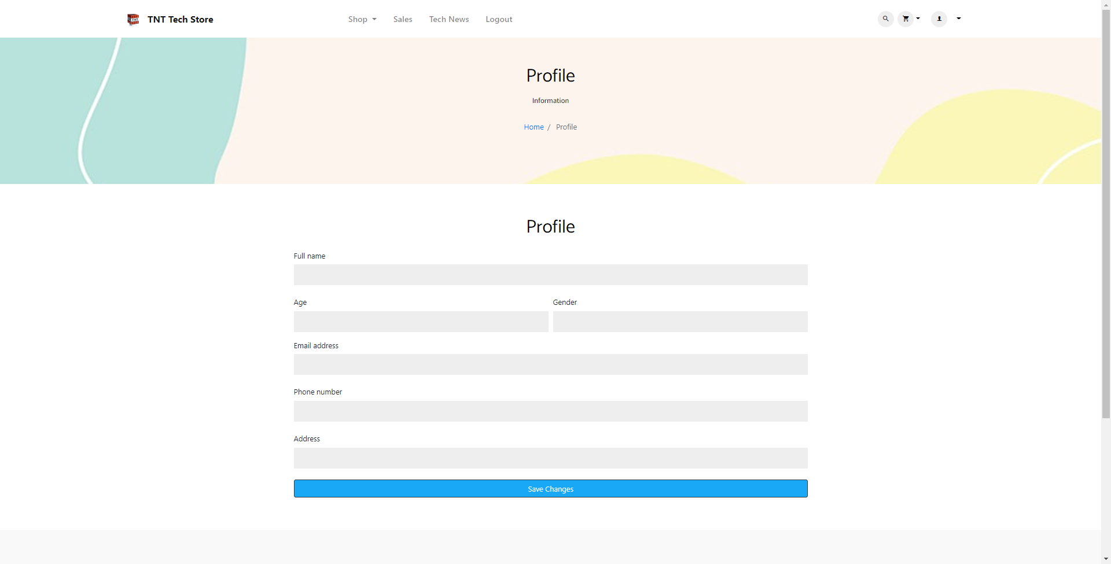
Profile page

Slide 13
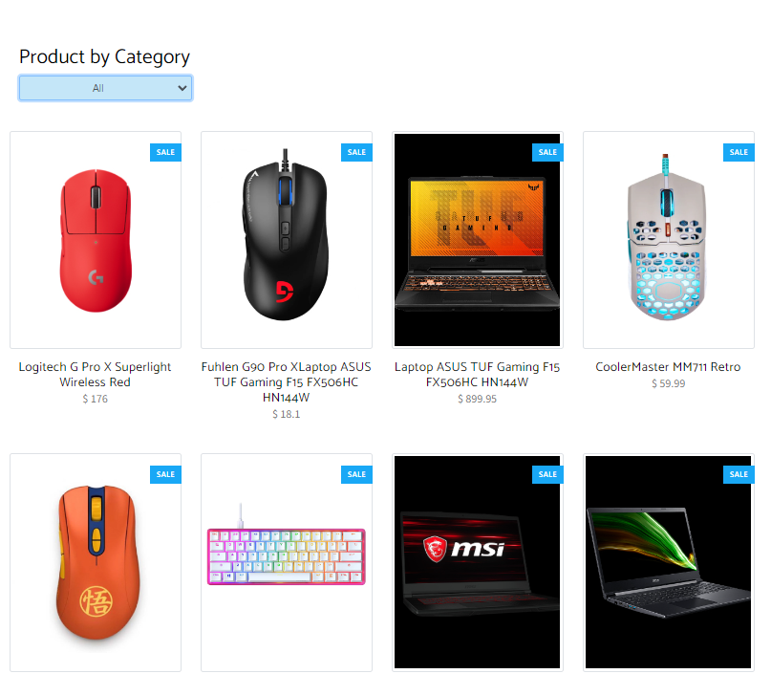
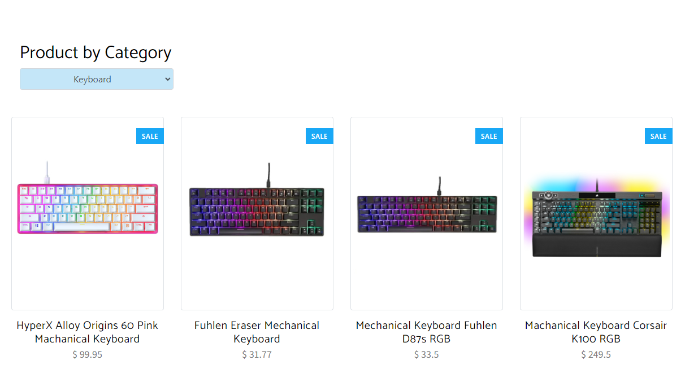
Showing product

Slide 14
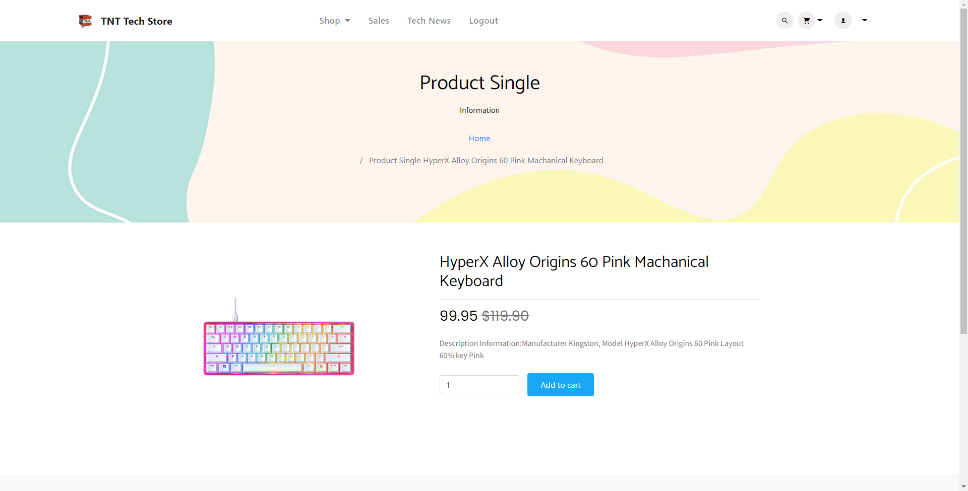
Single product page

Slide 15
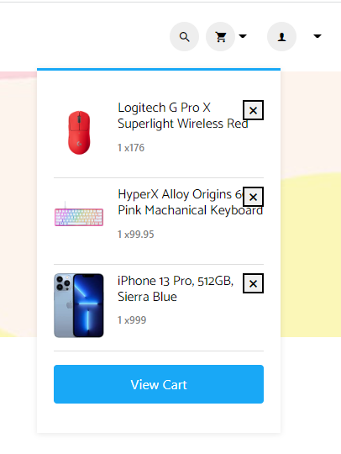
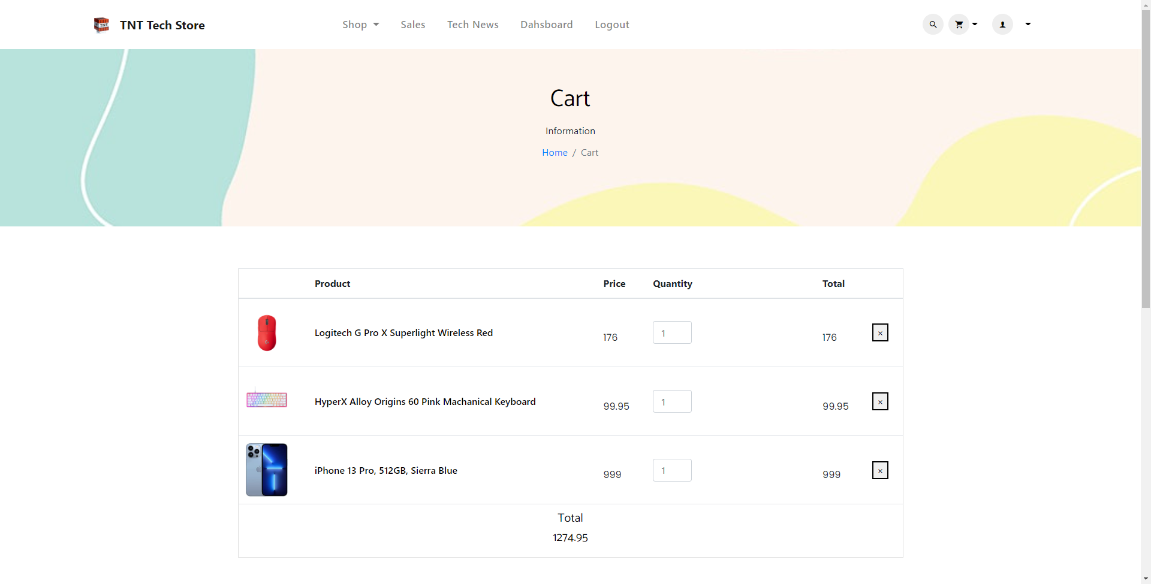
View cart and cart page

Slide 16
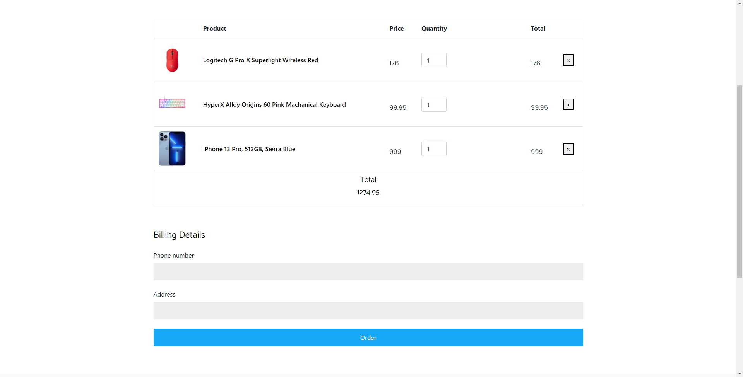
Order

Slide 17
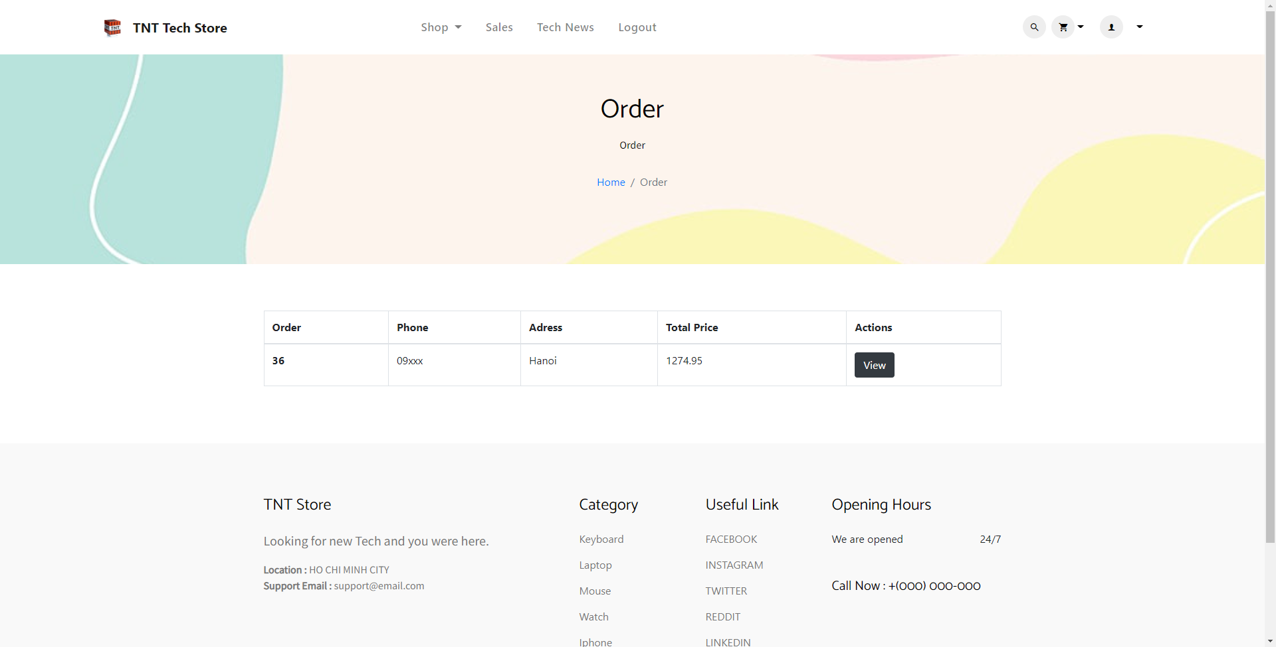
Order history page

Slide 18
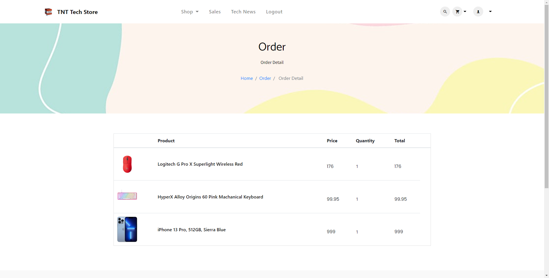
Order Detail Page

Slide 19
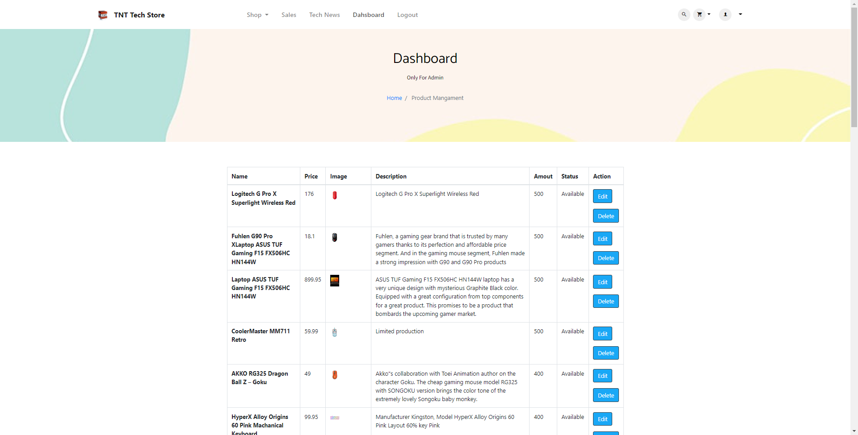
Manage product page

Slide 20
Future development
There are some bugs left to be fix.
Payment feature.
Online chat with seller for customers.

Slide 21
Thank you

